Slide 1
PACE-UP Next-Steps Web App

Slide 2
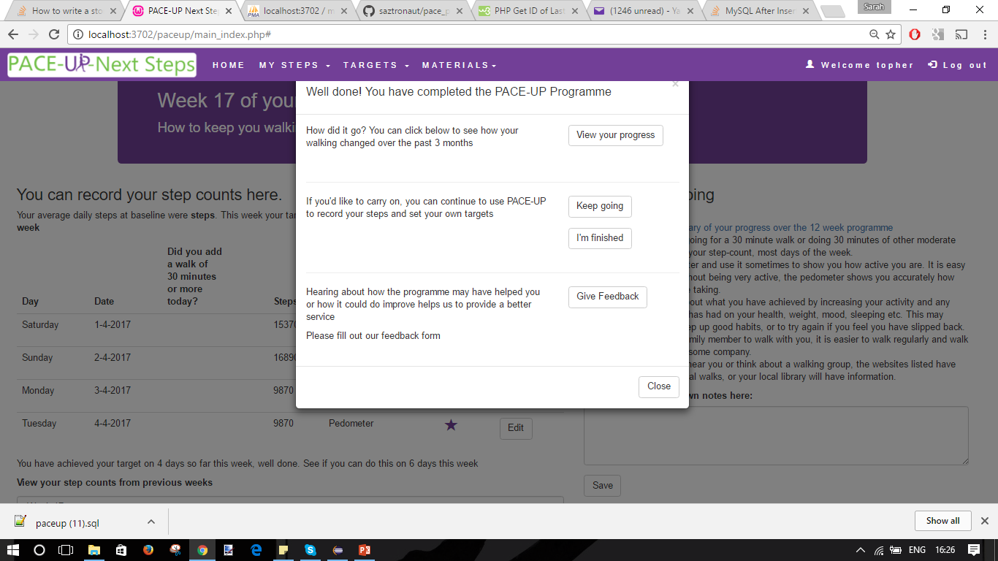
12 week summary

Slide 3
12 week summary
View progress
Keep going vs finish
Questionnaire
I think there might be too many options for the dialog box. How would you like it to look?

Slide 4
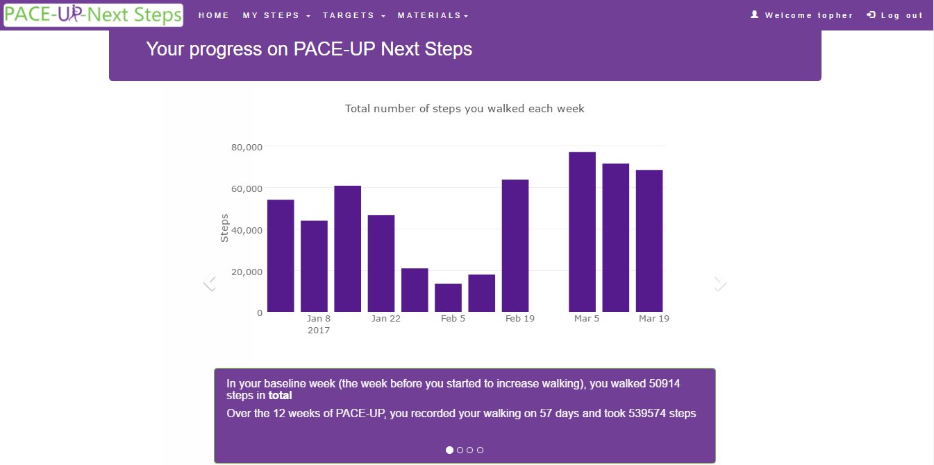
12 week feedback step count

Slide 5
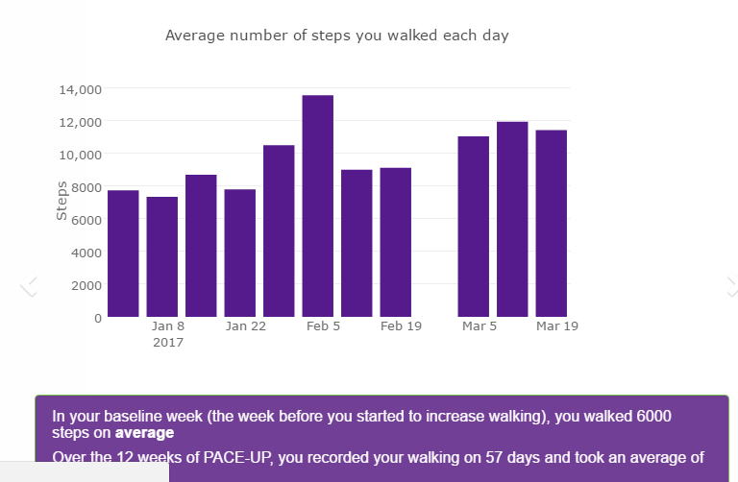
12 week feedback average steps

Slide 6
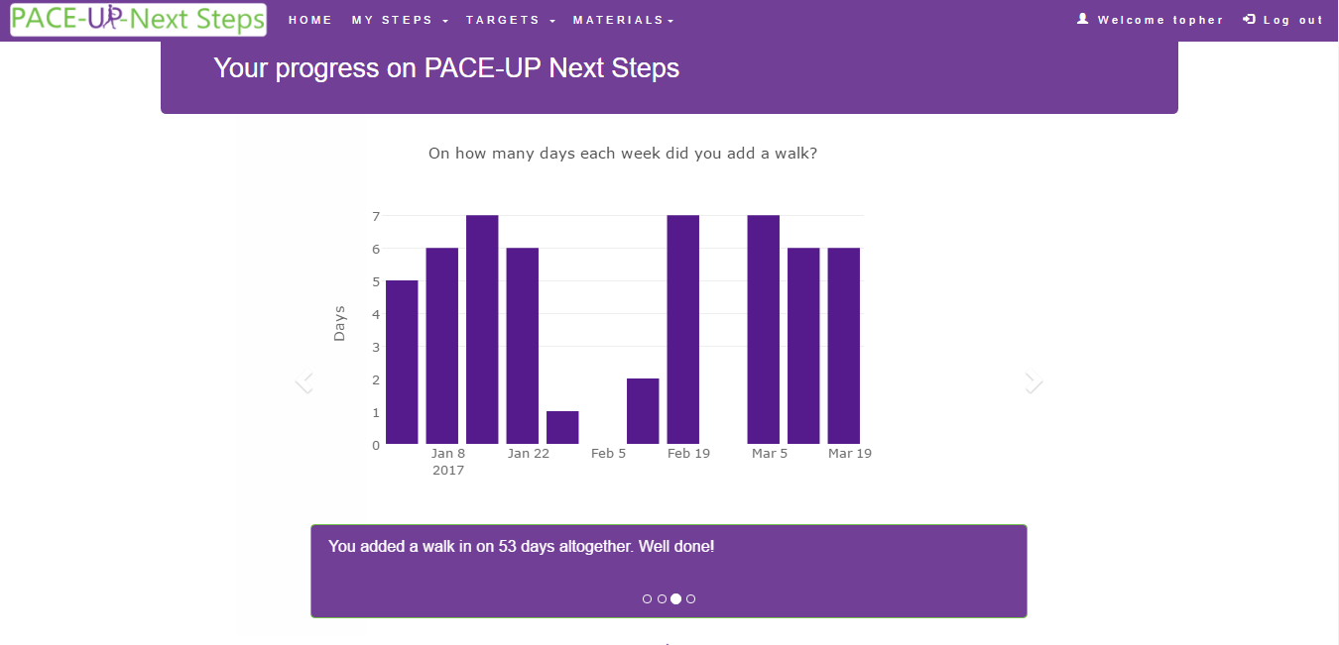
12 week feedback adding walk

Slide 7
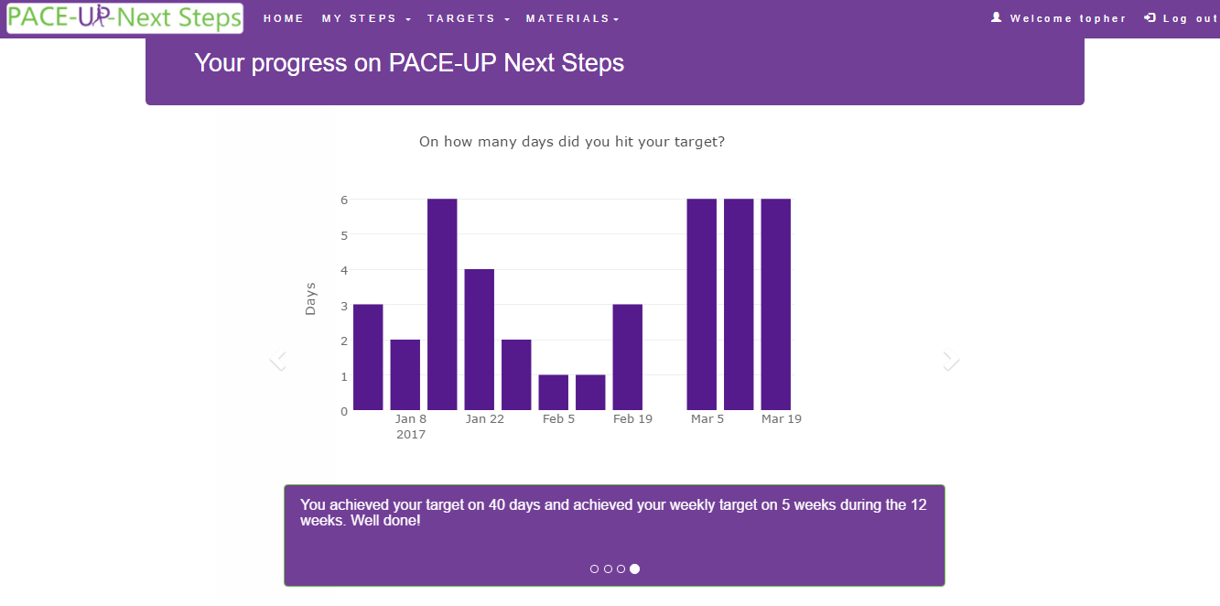
12 week feedback targets

Slide 8
After 12 weeks
If participant chooses to carry on, then they will be able to set their own targets
The week number is chronological from week 12, not dependent on the target
Do you want the target to include the number of days to hit it or just a daily target?

Slide 9
Things that need doing
Questionnaire
Altering server side code so Sam can use it
Altering logic to handle post 12 week bugs
Set target post 12 week
Set up table to log download activity, and write server side code.

